Slide 1

CMR Technical Campus Department of CSE
Real Time Research Project / Societal Related Project
Project Title: Real-time – Advance Budget Tracker
Presented By:
H. No:227R1A0552 Name: RISHIKESH MISHRA
Project Guide:
Name: MR SVSV PRASAD
Designation: ASSISTANT PROFESSOR
Project Co – Ordinator :
Name: V Srinu
Designation: ASSISTANT PROFESSOR

Slide 2
Index
Abstract
Introduction
Literature Review
Proposed methodology
Problem Definition
Objectives
Features
Result
Requirement Analysis
Design/Architecture
Referenes

Slide 3
Abstract
This project presents the development of a real-time daily expense tracker using PHP and MySQL. The system is designed to help users keep track of their expenses on a daily, weekly, monthly, and yearly basis. By storing data in a MySQL database and providing a user-friendly interface through PHP, this application aims to enhance personal financial management and reporting efficiency.

Slide 4
Introduction
In today's fast-paced world, managing personal finances efficiently is crucial.
An expense tracker is a tool that allows individuals to record and monitor their spending habits.
This project focuses on building a robust and user-friendly expense tracking system that leverages the power of PHP for backend processing and MySQL for data storage.

Slide 5
Literature Review
Personal Financial Management:
Emphasizes the importance of tracking daily expenses for effective financial management.
Entity-Relationship Diagram (ERD):
Fundamental for designing a structured database schema.
Database System Concepts:
Covers relational database design, SQL, and transaction management.
Relational Database Design:
Focuses on database normalization, indexing, and query optimization.
Use Case Diagram:
Helps identify user interactions and requirements for application design.

Slide 6
Proposed Methodology
System Design:
Design database schema using ERDs for efficient data management.
Development:
Implement frontend with HTML, CSS, JavaScript for responsive UI.
Develop backend using PHP for server-side logic and MySQL for database.
Deployment:
Deploy on web server (e.g., Apache).
Configure for cross-platform compatibility.

Slide 7
Problem Definition
Despite the availability of various expense tracking tools, many lack real-time updates, user-friendly interfaces, and comprehensive reporting features.
Users need a system that can seamlessly integrate with their daily activities, providing instant insights into their spending patterns across different timeframes.

Slide 8
Objectives
The primary objectives of the project are:
Develop a real-time expense tracking system.
Enable daily, weekly, monthly, and yearly expense reports.
Ensure user-friendly interface and easy navigation.
Implement secure and efficient data storage with MySQL.
Provide insights and analytics to help users manage their finances better.

Slide 9
Features
The Daily Expense Tracker comes with a variety of features designed to simplify and enhance personal financial management. Key features include:
Real-Time Data Entry:
Instantly record expenses as they occur.
User-friendly input forms to quickly add details.
Categorization:
Organize expenses into predefined categories (e.g., Food, Travel, Bills).
Customizable categories to suit individual needs.

Slide 10
Search and Filter:
Easily search for specific expenses by date, category, or amount.
Filter expenses to view specific data sets.
Budget Tracking:
Set budget limits for different categories.
Receive alerts when nearing or exceeding budget limits.
Secure Login:
User authentication to protect personal financial data.
Secure password storage and recovery options.

Slide 11
Comprehensive Reports:
Generate daily, weekly, monthly, and yearly reports.
Visual representations with charts and graphs for better insight.
Responsive Design:
Accessible on various devices, including desktops, tablets, and smartphones.
Adaptive layout for seamless user experience across platforms.
Export Data:
Export expense data to CSV or Excel for external analysis.
Easy backup and sharing options.

Slide 12
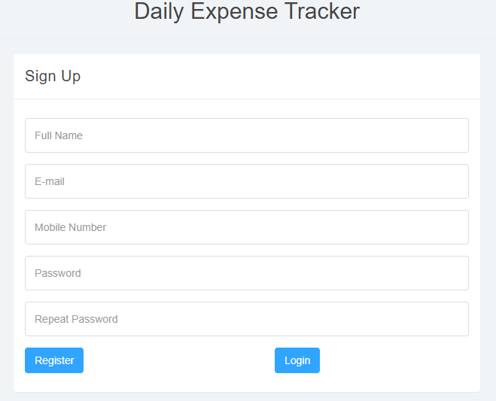
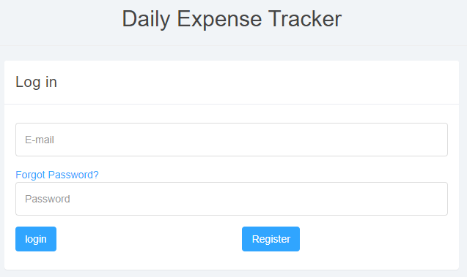

Slide 13
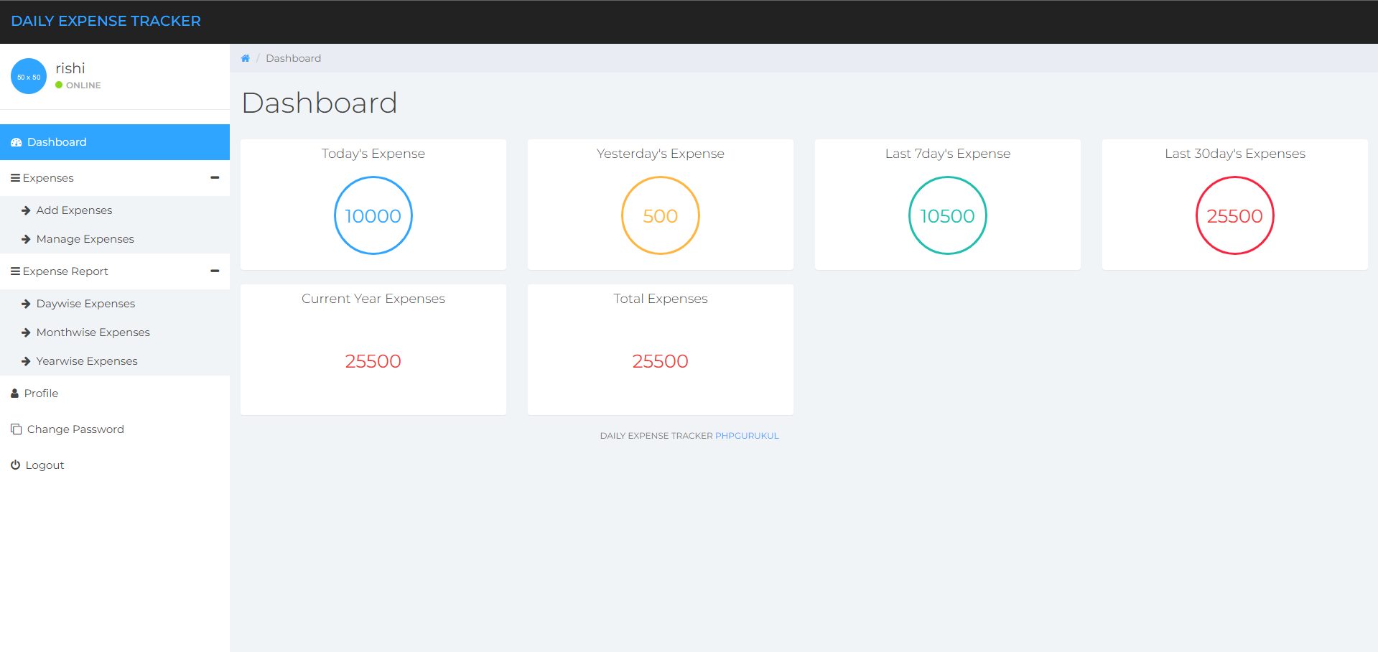

Slide 14
Minimumm requirement Analysis
Hardware Requirements:
Server with PHP and MySQL support.
Client device with internet access.
Software Requirements:
PHP 7.0 or higher.
MySQL 5.6 or higher.
Web server (Apache/Nginx).
Browser (Chrome, Firefox, etc.).

Slide 15
Design/Architecture
System Architecture:
Frontend: HTML, CSS, JavaScript for user interface.
Backend: PHP for server-side processing.
Database: MySQL for storing user data and expenses.
Flow Diagram:
User inputs expense data → Data is processed by PHP backend → Data is stored in MySQL database → Reports generated and displayed to user.

Slide 16
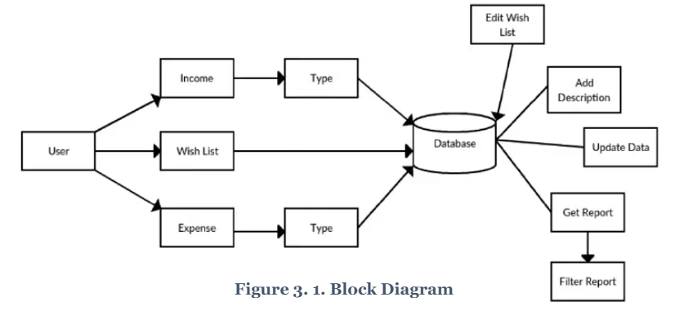
Data flow

Slide 17
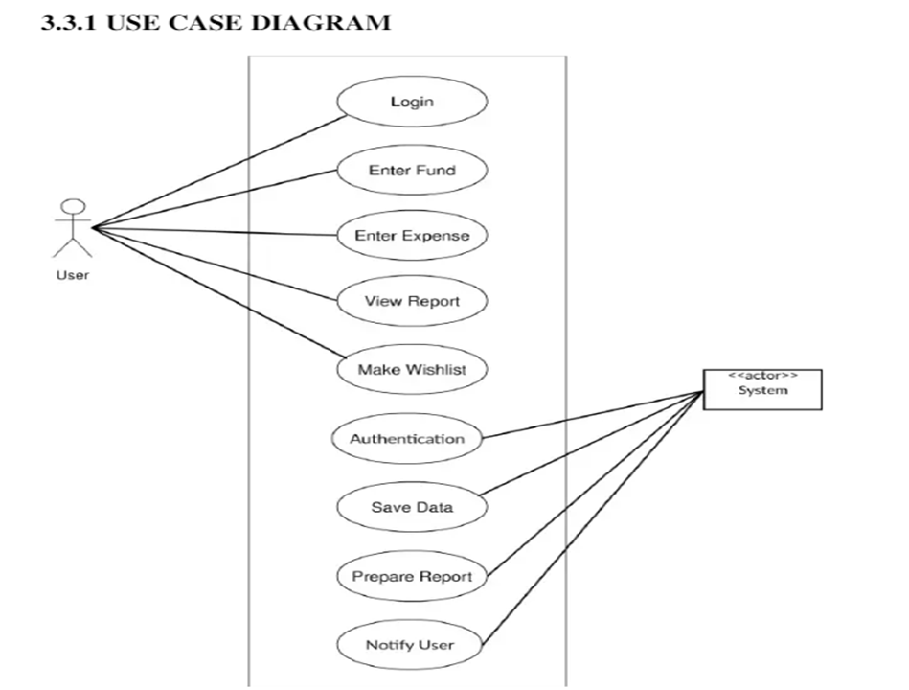

Slide 18
REFERENCES
[1] Personal financial management learning from www. thepersonalfinan
cier.com visited at 27th January, 2012.
[2] Entity relationship diagram concept from http:// en. Wikipedia .
org/wiki/Entity–relationship_model visited at 14th February, 2012.
[3] Abraham Silberschatz, Henry F. Korth, S. Sudarsham, “Database”,
Database System Concept, the McGraw-Hill Co Inc., Third Edition.
[4] Jan L. Harrington, “Relational Database Design Clearly Explained”, 2nd
Edition, John Wiley, 2010.

Slide 19

Thank You

